Slide 1

SC1015 Mini-Project
Jun Hao U2322364F
Karthik Raj U2320917J
Usama U2321431L

Slide 2
Introduction
Exploratory Dataset Analysis
Contents
Machine Learning
Insights

Slide 3

Introduction

Slide 4

"Every 40 seconds, someone loses their life to suicide. These statistics remind us of the urgent need for mental health support and suicide prevention efforts worldwide."
GLOBAL SUICIDE STATISTICS

Slide 5

Background
An estimated 703,000 people die by suicide worldwide each year which is 1.3% of all death in the world in 2019¹. This is more than HIV, malaria, breast cancer, war, and homicide.
While the global rate of suicide is showing signs of a decline, this is not the case in all countries and may be indicative of greater surveillance or access to data.
Practical Motivation
To predict the number of suicides using socioeconomic factors.

Slide 6


Problem Statement
What socioeconomic factors might be behind the suicide rates in the world?

Slide 7
Contains numerical information that spans over 30 years(1990-2022) regarding the causes of high suicide rate
Our Dataset
https://www.kaggle.com/datasets/ronaldonyango/global-suicide-rates-1990-to-2022

Slide 8


World Health Organization
World Bank

Slide 9

Data Cleaning

Slide 10
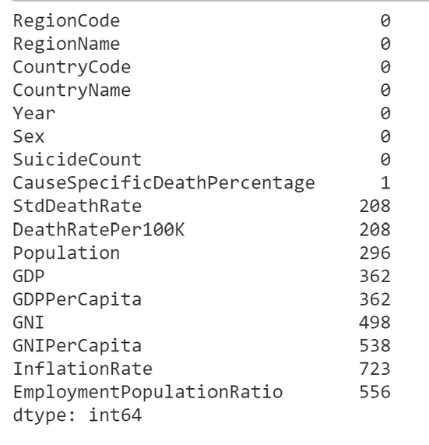
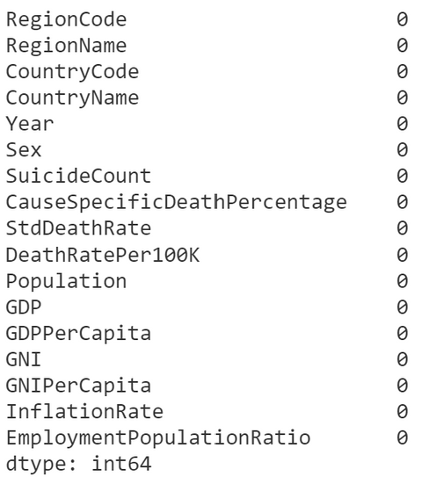
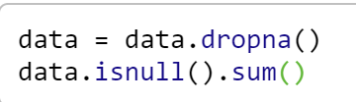
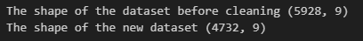
Cleaning Dataset
Shows the column having NO null values
Shows the column having null values

Slide 11
Selecting Relavant Columns
RegionCode: Unique identifier for the region (e.g., South Asia, Europe)
Year: Year for which the data was collected
Sex: Gender
GDPPerCapita: Economic output per person of a country in US Dollars
GNIPerCapita: GNI per person adjusted for purchasing power parity
Inflation Rate: The annual increase in consumer prices, essentially how much more expensive things are getting year-over-year
Employment Population: Percentage of population aged 15+ that is employed
StdDeathRate: Age standardized death rate from suicide per 100,000 people

Slide 12
Target Variable
We decided to choose StdDeathRate as our target variable as it shows the percentage of death that is caused by suicide. So if we can predict this data we can reduce the amount of suicide to reach our ultimate goal.

Slide 13

Exploratory Analysis

Slide 14
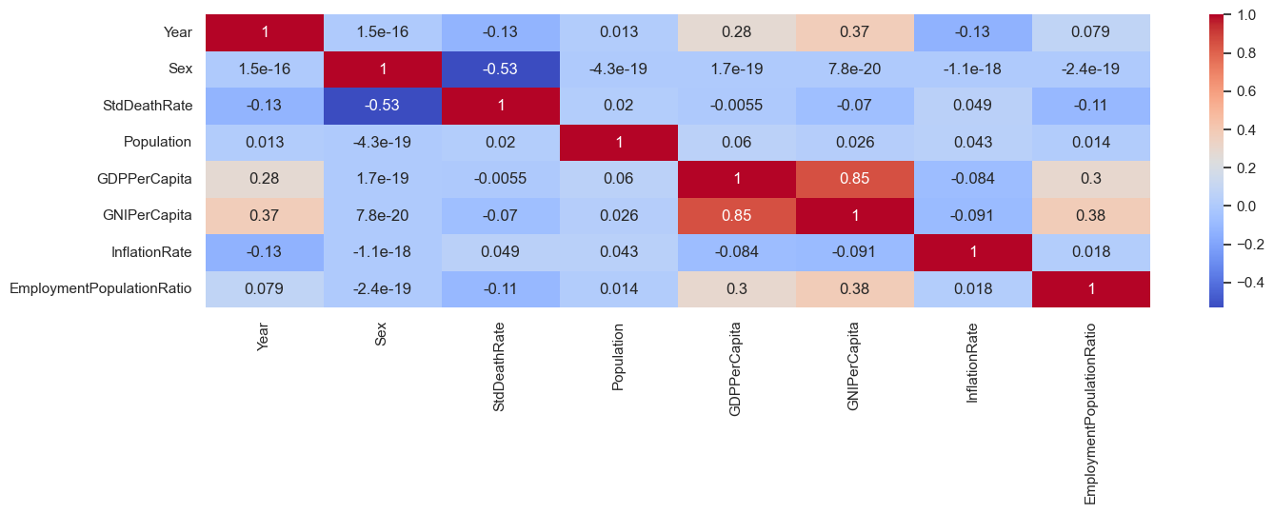

Correlation for Male and Female
Sex has a strong correlation with StdDeathRate

Slide 15
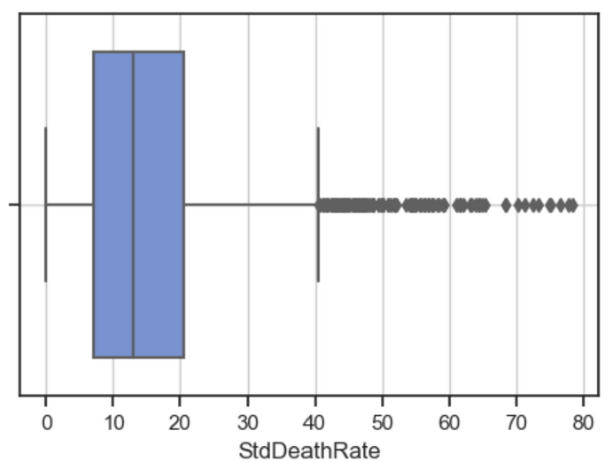
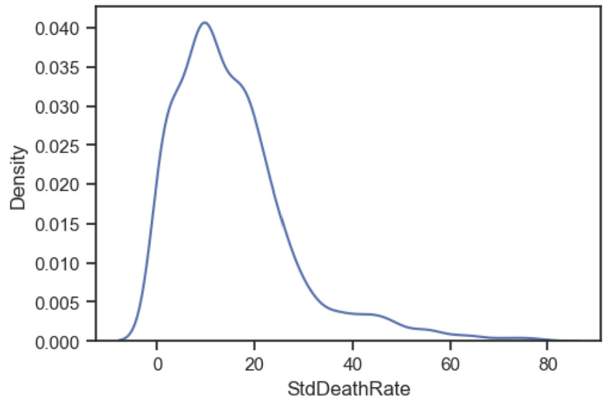
Standard Death Rate(Male)
Total Count : 2366 | Total Count : 2366
MEAN | 15.386219
STD | 12.341733
MIN | 0
25% | 7.099932
50% | 12.882924
75% | 20.425168
MAX | 78.310807

Slide 16
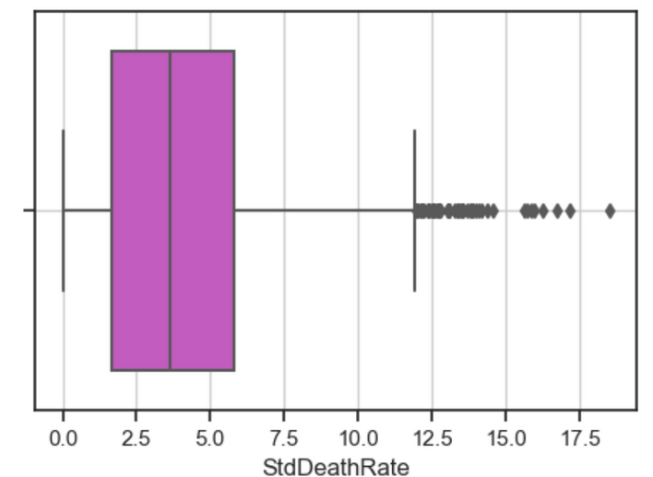
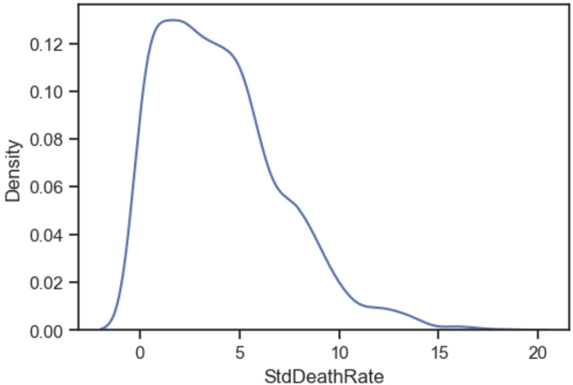
Standard Death Rate(Female)
Total Count : 2366 | Total Count : 2366
MEAN | 4.058674
STD | 3.075686
MIN | 0
25% | 1.655984
50% | 3.615216
75% | 5.781007
MAX | 18.502994

Slide 17
Total Count : 2366 | Total Count : 2366
MEAN | 15.386219
STD | 12.341733
MIN | 0
25% | 7.099932
50% | 12.882924
75% | 20.425168
MAX | 78.310807
Total Count : 2366 | Total Count : 2366
MEAN | 4.058674
STD | 3.075686
MIN | 0
25% | 1.655984
50% | 3.615216
75% | 5.781007
MAX | 18.502994
>

Slide 18
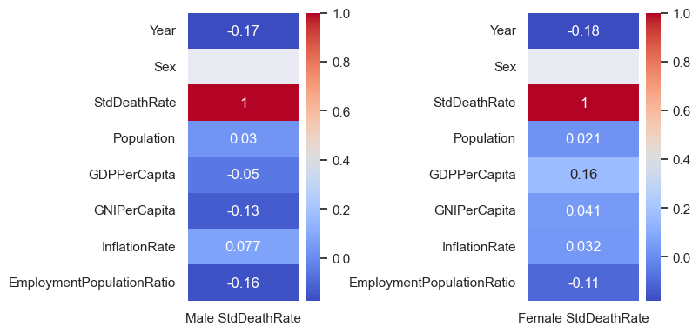
Correlation for Male and Female StdDeathRate Vs All Other Factors

Slide 19
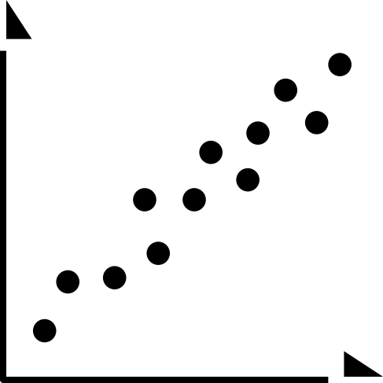
Correlation for Female & Male StdDeathRate Vs All Other Factors
Males:
Correlation between StdDeathRate and InflationRate, Population and GDPPerCapita is low. Can Explore GNIPerCapita for Males.
Females:
Correlation between StdDeathRate and InflationRate, Population and GNIPerCapita is low. Can Explore GDPPerCapita for Females.

Slide 20
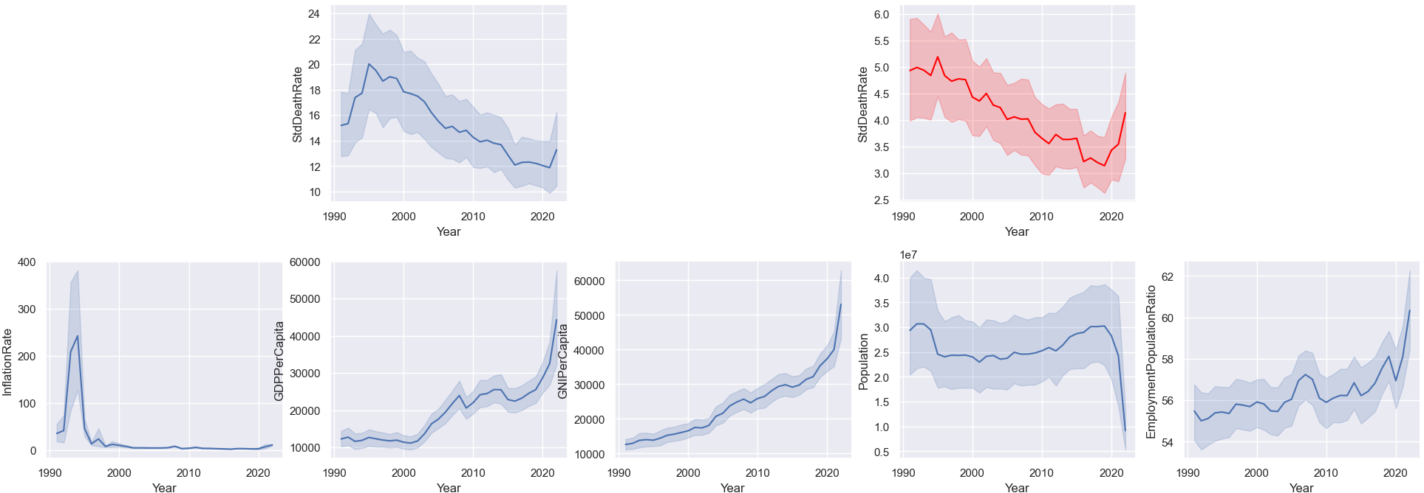
General Trend
Trend of suicide between the genders is generally the same
As GDP rises the Global Inflation Rate generally stays the same except for around the 1990s

Slide 21
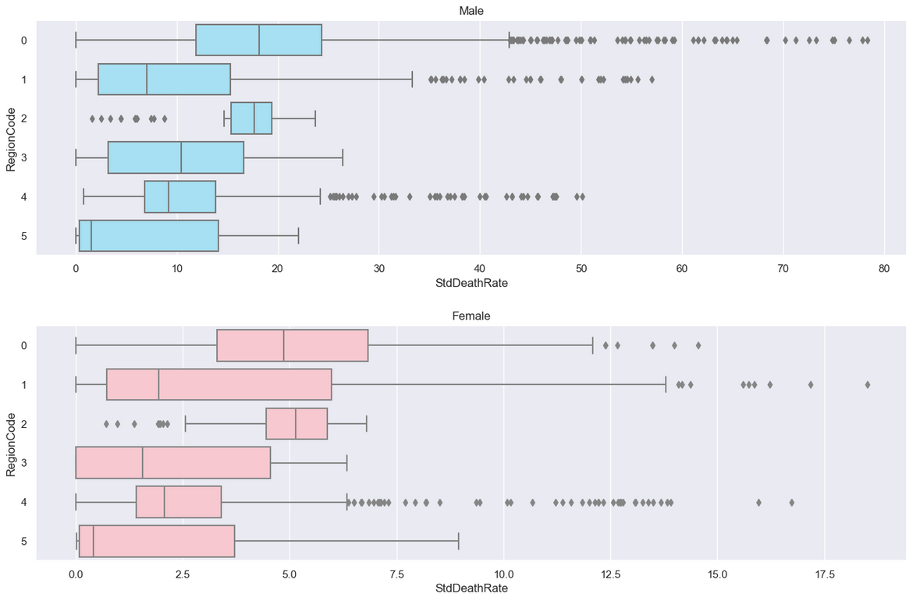
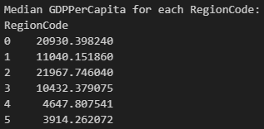
Region Code
Insights
From the models given we can derive that region plays a big factor in suicide rate.
Regions that are richer on average has higher suicide rate.

Slide 22
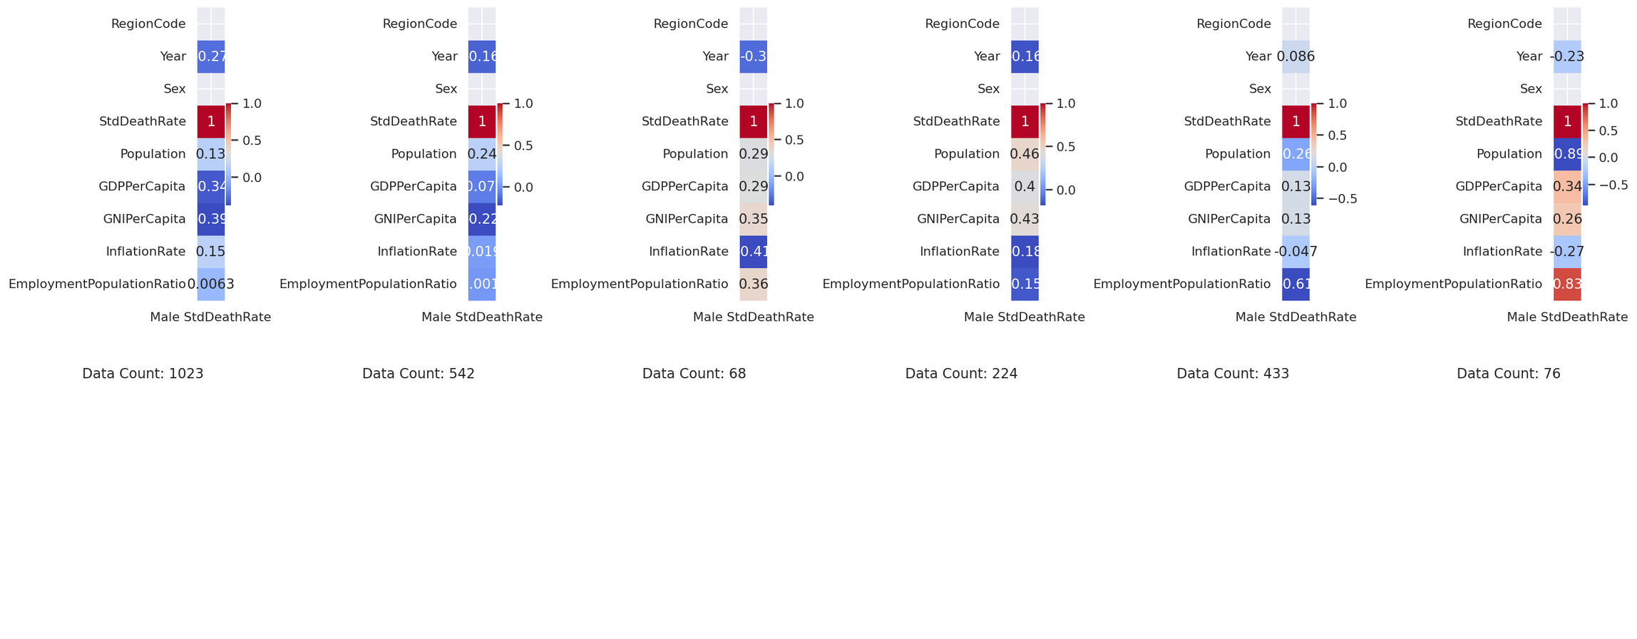
Male Correlation Matrix Against The 6 Regions

Slide 23
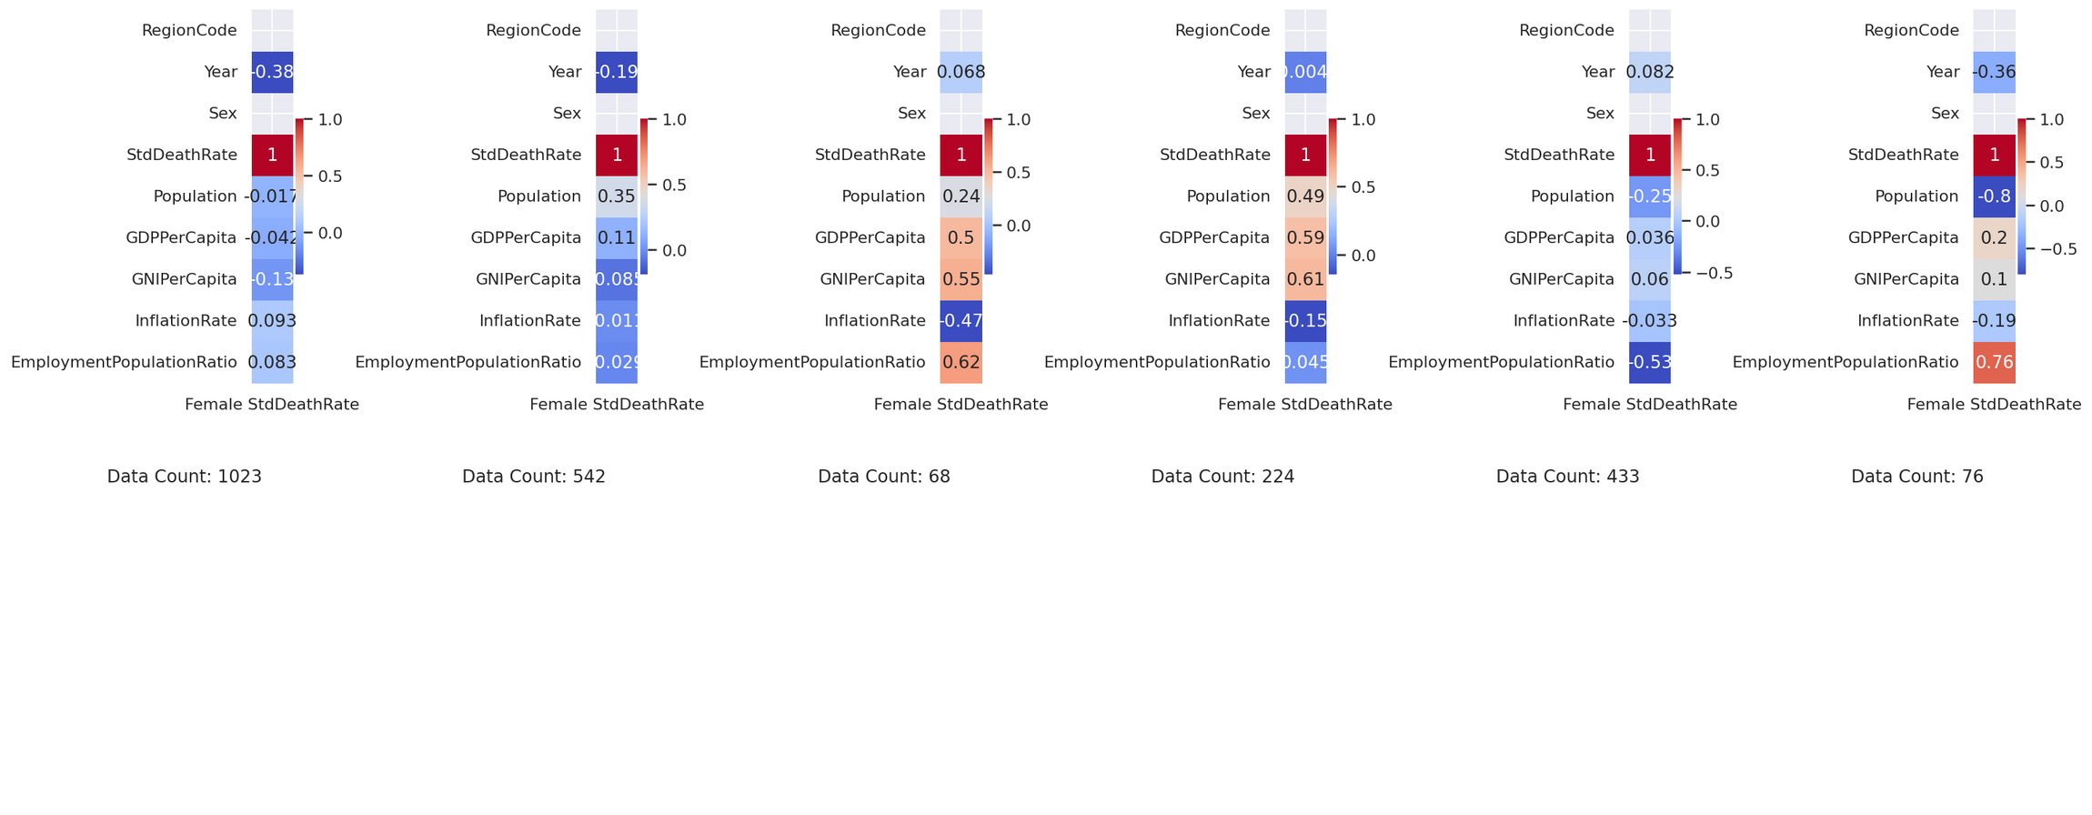
Female Correlation Matrix Against The 6 Regions

Slide 24

Insights From The Two Correlation Matrix
From the 2 matrix, we can identify which region we can use to explore
Oceania (2) - 68 Data Points
Central and South America (3) - 224 Data Points
Africa (5) - 78 Data Points
Europe (0) - 1023 Data Points
Asia (1) - 542 Data Points
Selected Regions to Continue Exploring
Not Enough
Data Points

Slide 25
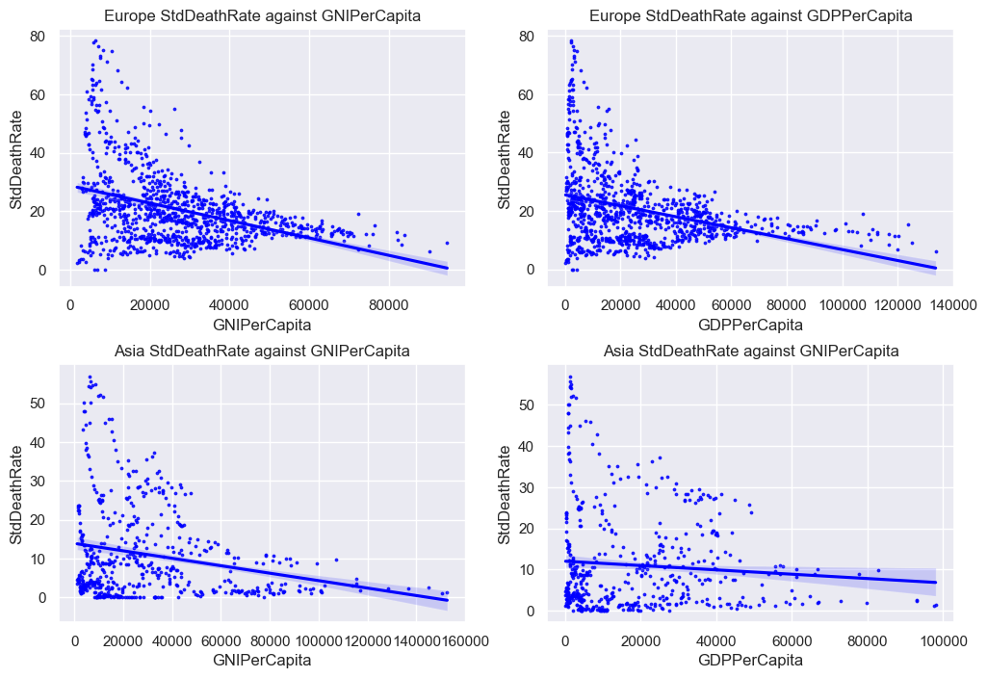
Male Correlation Matrix for GNIPerCapita Against StdDeathRate For All Regions
Insights
Negative Correlation between StdDeathRate and GNIPerCapita / GDPPerCapita in Europe.
We can tell that the higher the GDPPerCapita or GNIPerCapita, the less variance in suicide rates.
The higher the GNI or GDPPerCapita, the lower the suicide rates as well.

Slide 26
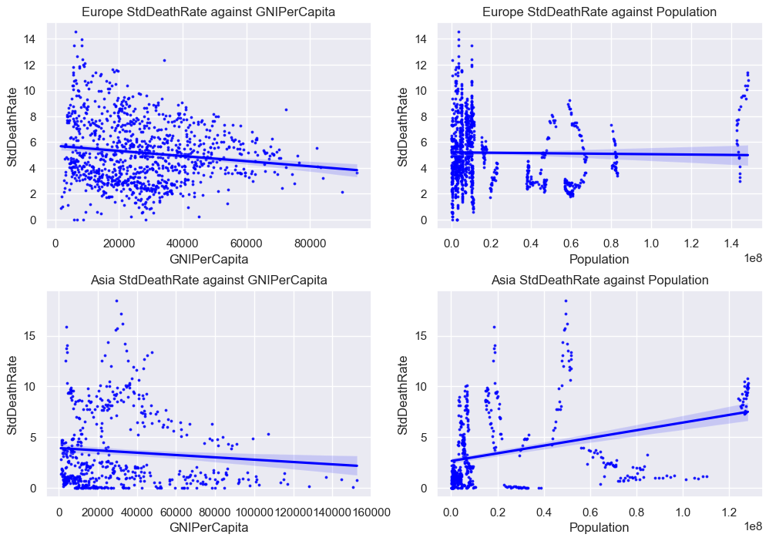
Female Correlation Matrix for GNIPerCapita Against StdDeathRate For All Regions
Insights
Weak Positive Correlation between StdDeathRate and Population Asia.
No correlation between StdDeathRate and Population in Europe
For GNIPerCapita, variance decreases as GNIPerCapita increases

Slide 27

Conclusion After Doing Exploratory Data Analysis
Male and female suicide trends are the same, but suicide occurs 2-3x more in males than females.
StdDeathRate which is our target variable does not have a strong correlation for females with our potential predictors, unlike male StdDeathRate which have a strong correlation with GNIPerCapita.
Some regions do not have enough data points for machine learning to be applied so we have selected Europe and Asia.
In conclusion, we decided to select Male’s GNIPerCapita as our predictor variable in Europe to do Machine learning on.

Slide 28

Machine Learning

Slide 29
Additional Data cleaning
Removing outliers for StdDeathRate & GNIPerCapita before inserting into model
Outliers can distort statistical measures such as the mean, standard deviation, and correlation coefficients.
Outliers can adversely affect the performance of predictive models by introducing noise and bias.
Outliers can skew the distribution of data and violate assumptions of statistical tests.

Slide 30
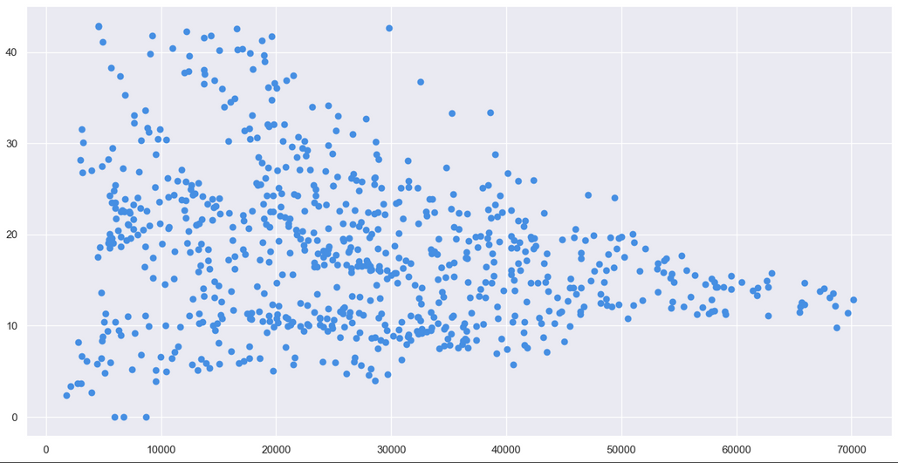
What was our Train & Test dataset
We conducted a regression analysis on a dataset comprising male population demographics in the European region. Our analysis focused on two key variables:
Gross National Income per Capita (GNI per Capita)
Standardized Death Rate (Std Death Rate)

Slide 31
Linear Regression Model
Polynomial Regression
Decision Tree Regression
Models used
Gradient Boosting Regression
Random Forest Regression

Slide 32
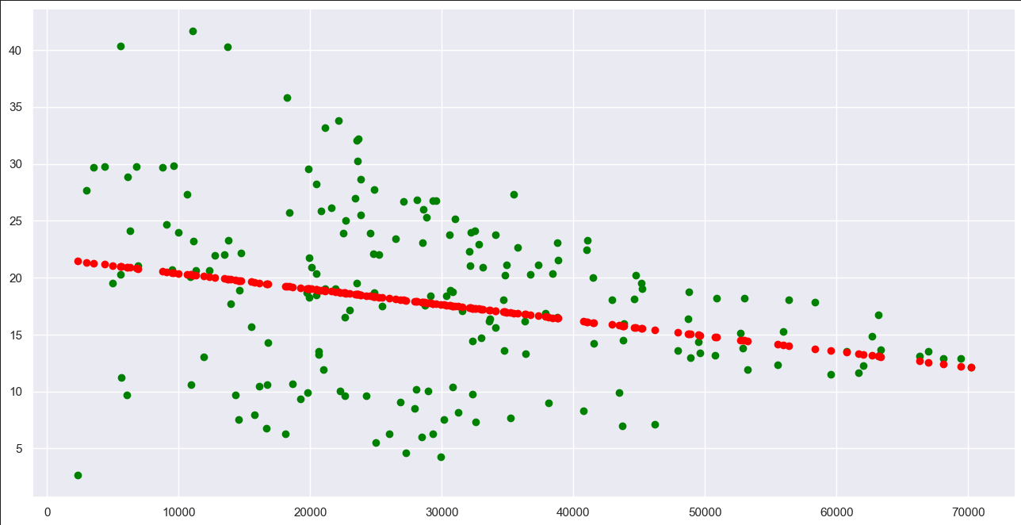
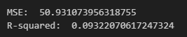
Best Model
Linear Regression
Insights
The linear regression model is shown to be the best model out of the other 5 models that were used. Even though the line has a negative gradient, it shows a strong relationship between GNIPerCapita and STDDeathRate

Slide 33
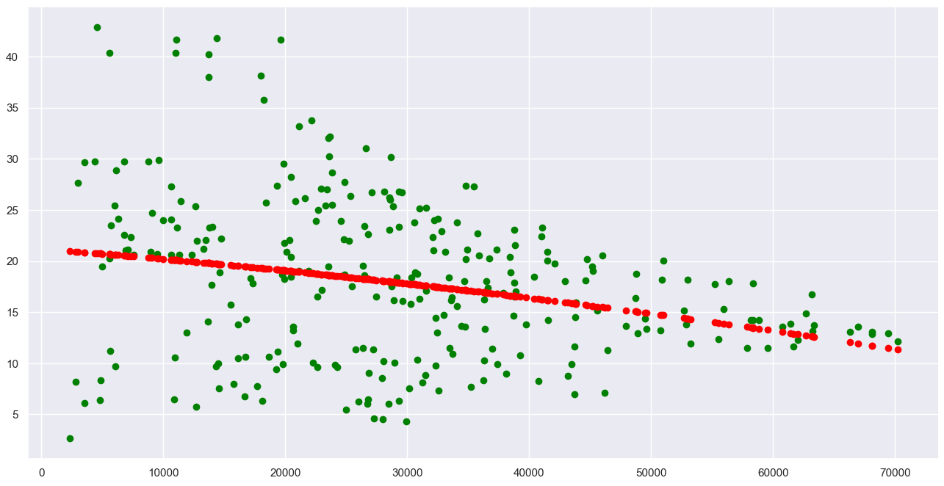
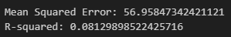
2nd Best Model
Polynomial Regression
Insights
The polynomial regression model captures some non-linear relationships between the predictor variable (GNIPerCapita) and the response variable (StdDeathRate). Through the model we can observe that it has limited predictive power

Slide 34
Other Models Attempted

Slide 35
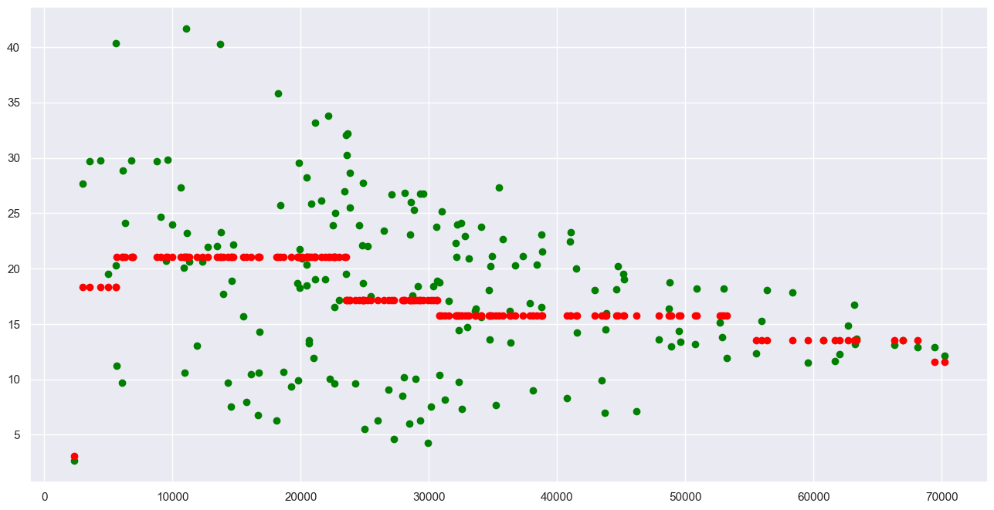
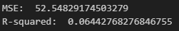
Other Model
Decision Tree
Insights
We have also attempted to use the decision tree model and it turns out to be worse than the linear and polynomial regression

Slide 36
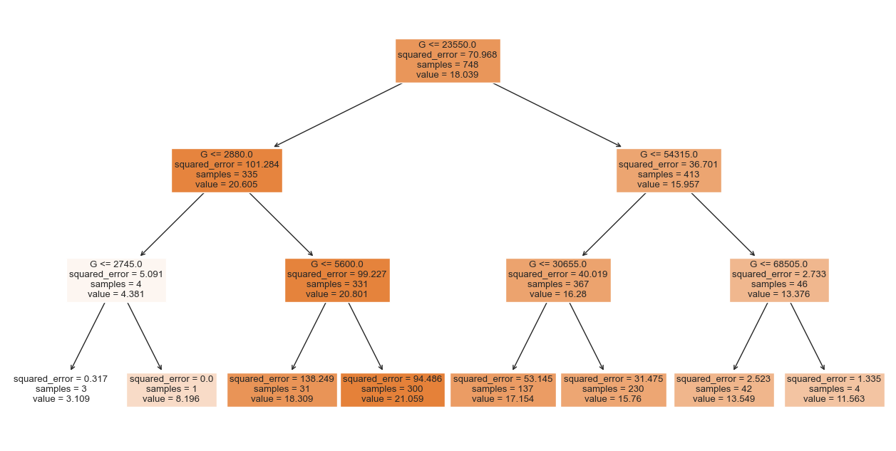
Decision Tree
Insights
When the GNIPerCapita is low, the squared error is high.

Slide 37
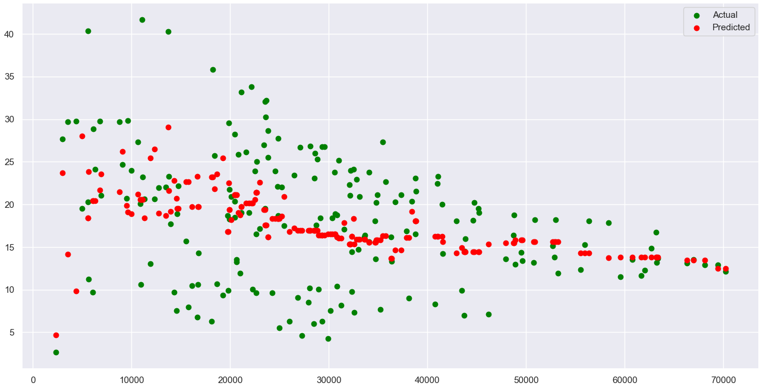
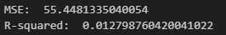
Other Models
Gradient Boosting Regression
Insights
We also have attempted this model which captures the non-linear relationship between STDDeathRate and GNIPerCapita

Slide 38
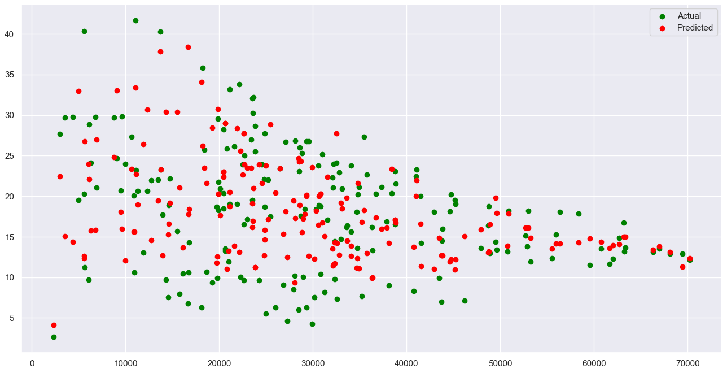
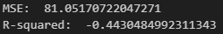
Worst Model
Random Forest Regression
Insights
Random forest regression is another model that shows the non-linear relationship between STDDeathRate and GNIPerCapita

Slide 39

Insights

Slide 40
Which models were successful,
which models were not successful
By the results of the 5 models that were used, we decided that 2 models could be used;
Linear Regression (Best)
Polynomial Regression (2nd best)
Decision Tree (Performed Average)
The other 2 models that we attempted to use performed much worse compared to Linear Regression and Polynomial Regression
Random Forest Regression by far produced the worst R^2 and MSE output
Gradient Boosting was bad but not as bad as random forest
Linear Regression > Polynomial Regression > Decision Tree > Gradient Boosting > Random Forest

Slide 41
What did we learn from the project ?
Peak and Fluctuation in global suicide rates:
Global Suicide rates have shown fluctuation over the years, peaking around 1997, decreasing subsequently, and then peaking again in 2021. This peak serves as a significant point of interest for further investigation into the societal, economic, and psychological factors that may have contributed to it.
Consistent Gender-Specific Trends:
Despite the stability in global suicide rates, the trend in suicide rates between genders has remained consistent over the years.
Recognizing the distinct factors including male and female suicide rates is essential.

Slide 42
What did we learn from the project ?
Economic Prosperity and Suicide Rates:
Our analysis revealed a strong correlation between economic prosperity, Gross National Income (GNI), and suicide rates.
We found that as GNIPerCapita increases, the variance of suicide rates decreases, indicating a more predictive model.
Moreover, our analysis showed that suicide rates tend to decrease as GNIPerCapita increases.

Slide 43
What did we learn from the project ?
Socioeconomic Factors:
Regional Variations in Suicide Trends:
Regional Variations suggest that socioeconomic factors, access to mental health services, and other variables may play a significant role in shaping these trends
By incorporating regional data into predictive models, we can develop more accurate and robust algorithms for forecasting suicide rates. These models can help identify high-risk areas and target intervention more effectively, leading to more targeted and efficient allocation of resources for suicide prevention efforts

Slide 44
Conclusion
Gender is a major factor when trying to build a model to predict the suicide rate of a country.
We found that while there is a correlation between economic prosperity and suicide rates, regional variations suggest that other factors such as sociocultural influence and access to mental health services, also play a big part in shaping these trends.
Specifically, indicators such as GNIPerCapita and GDPPerCapita showed a significant correlation with male suicide rates. However, the correlation between socioeconomic factors and female suicide rates was less pronounced, indicating the need for further investigation.
Based on the findings, we can suggest that suicide rates become more unpredictable

Slide 45
References
World Health Organization. Suicide worldwide in 2019: global health estimates. Available from: https://www.who.int/publications/i/item/9789240026643. [Accessed 10 April 2024]
World Health Organization. (n.d.). Suicide: One person dies every 40 seconds. World Health Organization. https://www.who.int/news/item/09-09-2019-suicide-one-person-dies-every-40-seconds#:~:text=%E2%80%9CDespite%20progress%2C%20one%20person%20still,Yet%20suicides%20are%20preventable.

